Slide 1
DIGITAL – ON LINE BANKING
Review Timelines & Validation of Deliverables completed as of Jan 22
Project
Charter
Project
Plan
Discovery
Initial
Design
Setup
Foundation
Establish
High Level Architecture
JANUARY 2020
FEBRUARY 2020
MARCH 2020

Slide 2
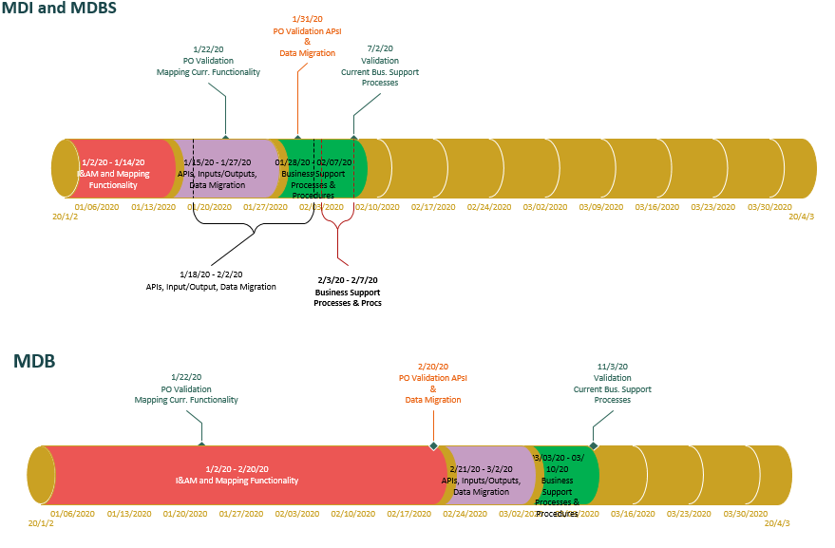
C1 Current State - BA Timelines

Slide 3
BA Work Breakdown Structure

Slide 4
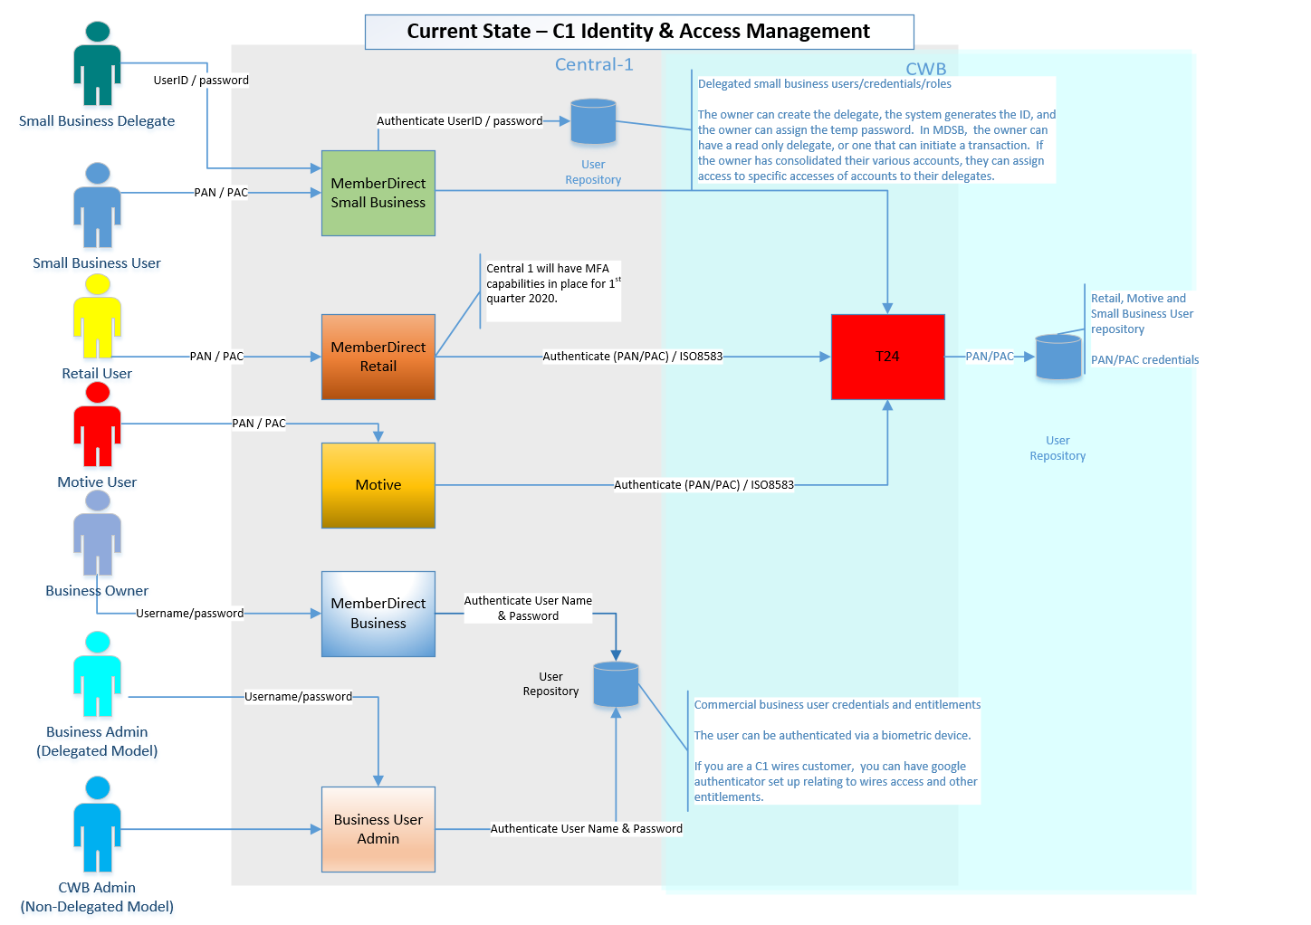
Identity & Access Management User Roles

Slide 5
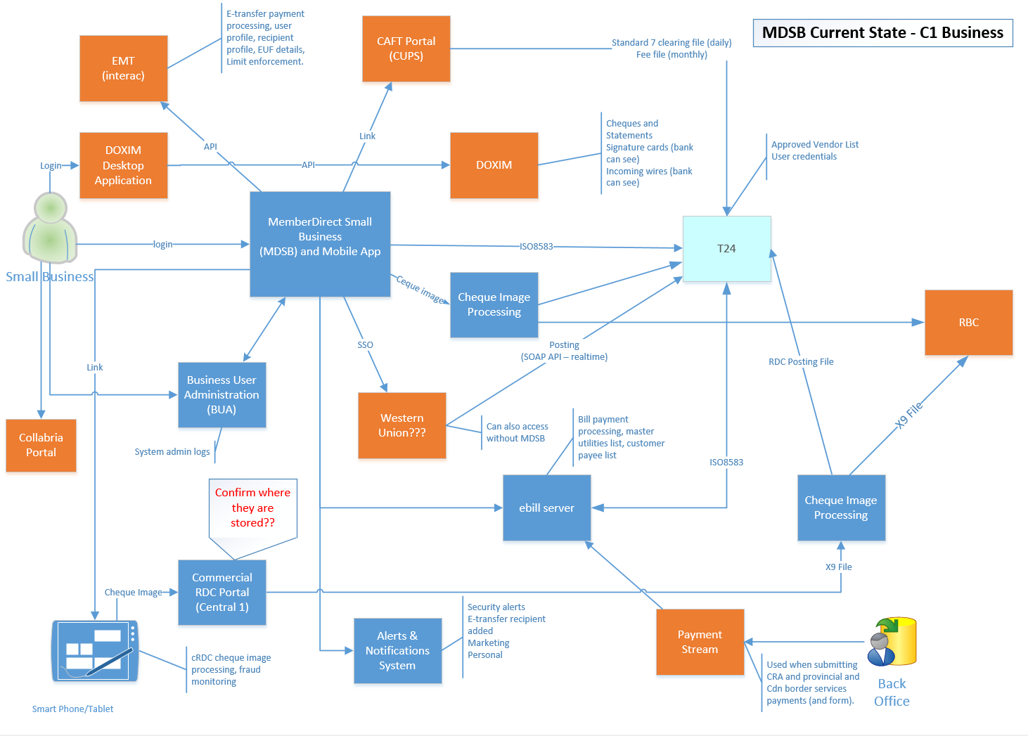
MDSB – Current State Context Diagram

Slide 6
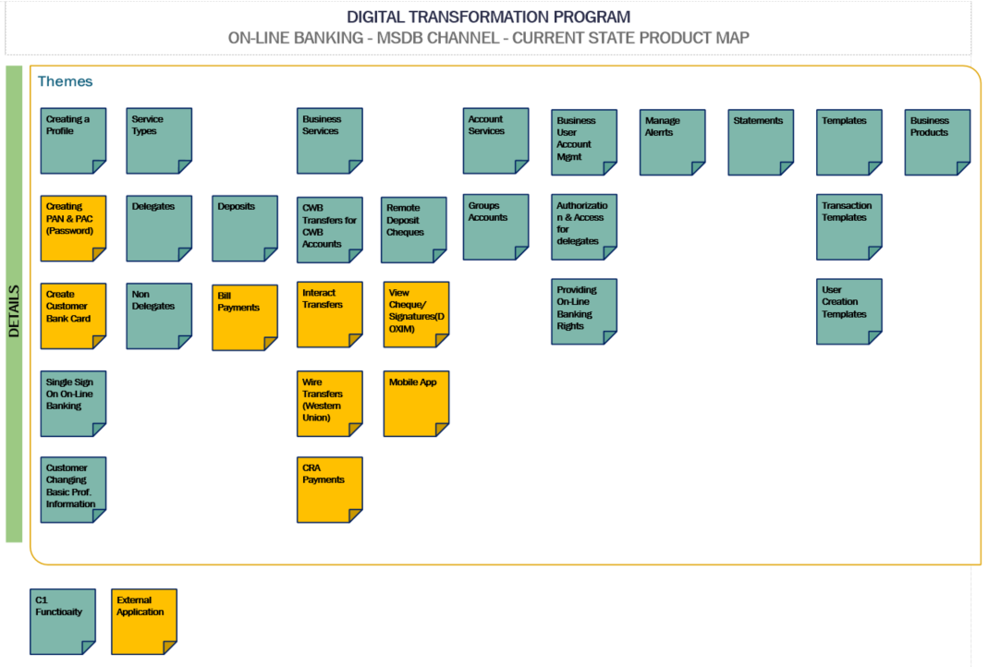
C1 – MDSB Channel - Current Product Map c

Slide 7
C1 – MDSB Channel – Product Functionality List

